Slide 1
JavaScript Functions
BDPA INDY SITES
04/04/20

Slide 2
Quick Quiz: Strings & Arrays
var str = “This is a sentence.”
var temp = str.indexOf(“is”);
var arr = [12, 7, 8, 11, 100];
var temp = arr[3];
What is the value of temp?

Slide 3
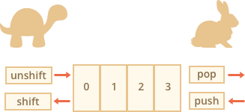
Queue Methods for Arrays
var exArray =
Method | Result
exArray.unshift(-1); | [-1, 0, 1, 2, 3]
exArray.shift(); | [1, 2, 3]
exArray.pop(); | [0, 1, 2]
exArray.push(4, 5); | [0, 1, 2, 3, 4, 5]

Slide 4
Queue Methods for Arrays
var exArray =
12
5
2
9
Method | Result
exArray.unshift(11, 2); | [11, 2, 12, 5, 2, 9]
exArray.shift(); | [5, 2, 9]
exArray.pop(); | [12, 5, 2]
exArray.push(1); | [12, 5, 2, 9, 1]

Slide 5
Any questions on Arrays?

Slide 6
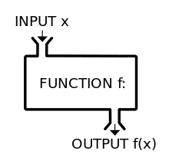
What is a function?
A function is a kind of mini-program that forms part of a larger program
are given a unique name, so that they can be called from elsewhere in the program.

Slide 7
Function Syntax
function name()
{
statement;
statement;
statement
}
name();
Uses the keyword function
It is named for easy referencing
All statements except the last statement must be followed by semi-colons
Call (execute) a function by its name with parentheses

Slide 8

Function Examples
function sayGoodbye()
{
alert("Goodbye!")
}
function sayHello()
{
alert("Hi, there!");
sayGoodbye()
}

Slide 9
Passing Parameters to a Function
Sometimes you want to supply a function with additional information
A parameter is a variable tied to a function
An argument is a value the function receives from a parameter at the time the function is called.
function name(parameter_1, parameter_2)
{
statement;
}
name(argument_1, argument_2);

Slide 10
Calling a Function with Parameters
function addVAT(price)
{
price *= 1.2;
alert(price)
}
addVAT(5)
OR
var nettPrice = 5;
addVAT(nettPrice)

Slide 11
Global vs Local Variables
var count = 0;
var sum = 10;
function method (occurrences) {
if sum < 20 {
var temp = 7;
occurrences ++;
}
}
method (count);
LOCAL variables are declared inside of a function.
They can only be accessed in that function
GLOBAL variables are declared outside of a function.
They can accessed anywhere

Slide 12
Global vs Local Variables
var count = 0;
var sum = 10;
function method (occurrences) {
if sum < 20 {
var temp = 7;
occurrences ++;
}
}
method (count);
What value does each variable hold?
count?
sum?
temp?

Slide 13
Returning a Value from a Function
The keyword return sets the output of a function; any data type can be passed
This output can be assigned to a variable and used elsewhere outside of the function
All functions return undefined by default if a return condition is not set
function add(a, b) {
return a + b;
}
var sum = add(10, 20);

Slide 14
What is a Recursive Function?
function power(num, pow) {
var result = 1;
for (var i = 0; i < pow; i++) {
result *= num
}
return result;
}
power(2, 2) = 4;
power(2, 3) = 8;
power(2, 4) =16;

Slide 15
Recursion vs For Loops
function power(num, pow) {
if(pow == 1) {
return num;
}
else {
return num * power(num, pow – 1)
}
}
function power(num, pow) {
var result = 1;
for (var i = 0; i < pow; i++) {
result *= num
}
return result;
}

Slide 16
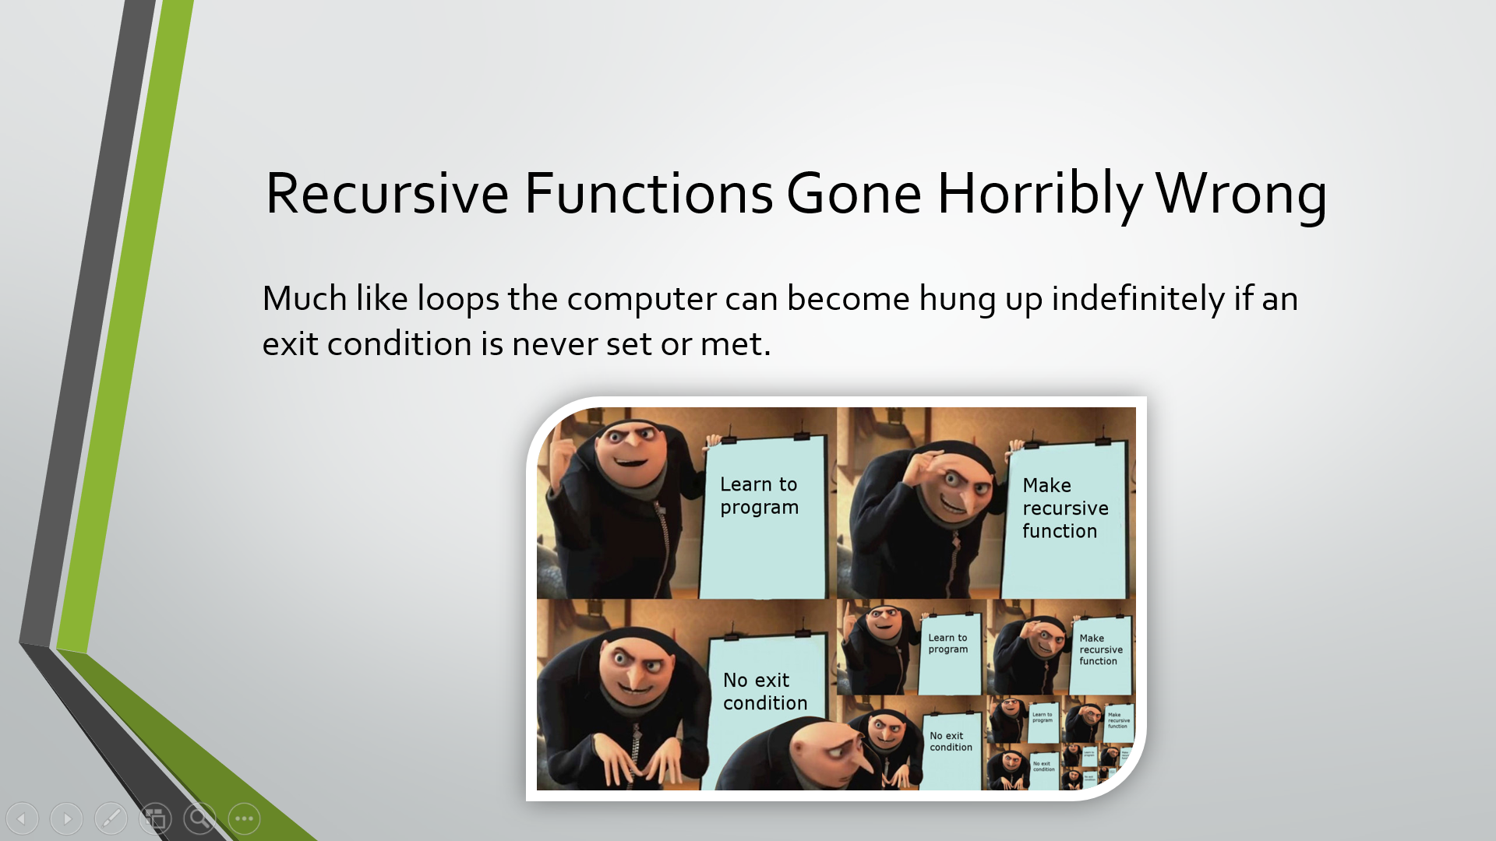
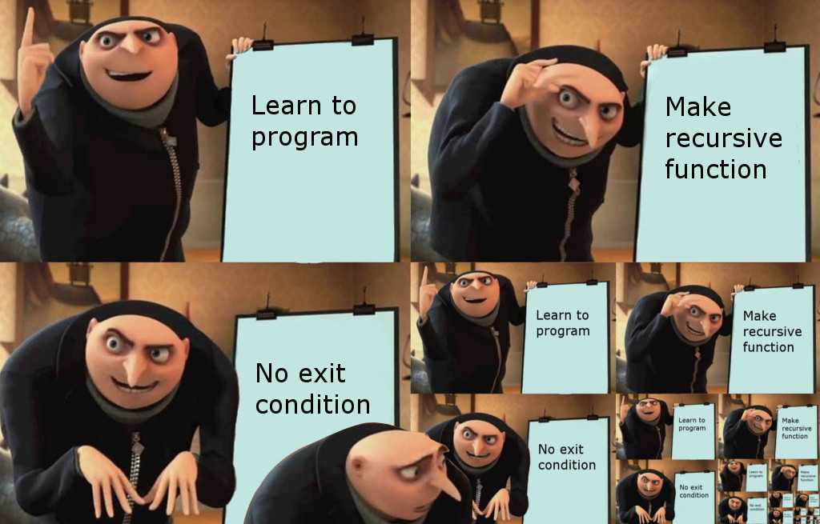
Recursive Functions Gone Horribly Wrong
Much like loops the computer can become hung up indefinitely if an exit condition is never set or met.

Slide 17
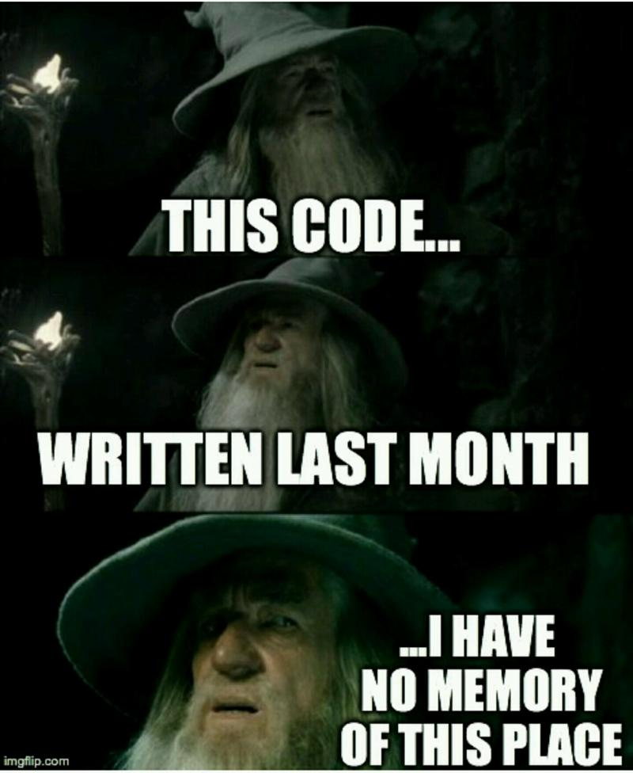
Commenting (please do it)
Comments are authored explanations of code that are ignored by the computer when executing code
// This is a single line comment
/* This is a comment is block comment.
It can span 2 or more lines. */

Slide 18
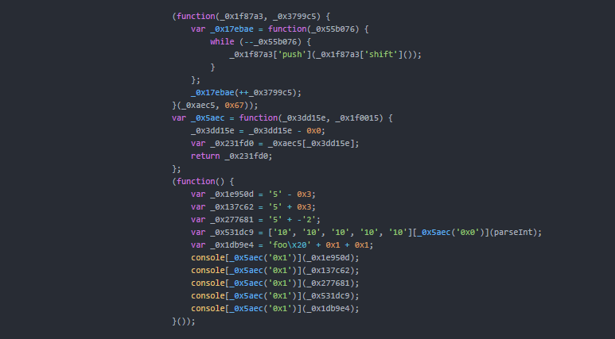
What does this segment of code do?

Slide 19
Any questions on functions?

